Slide 1



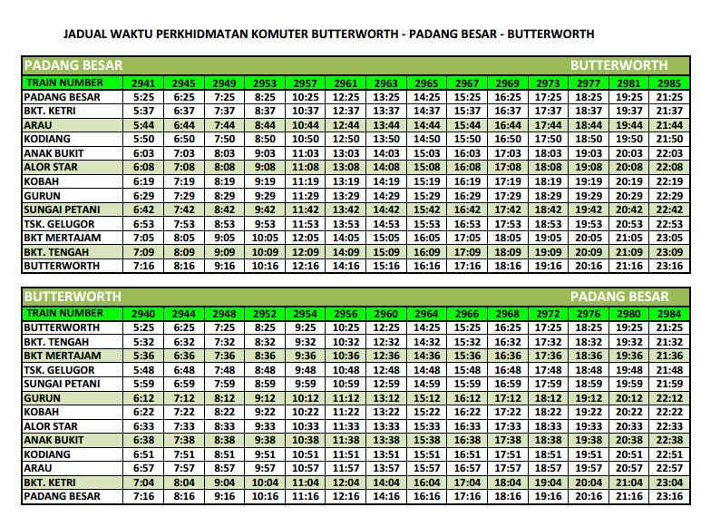
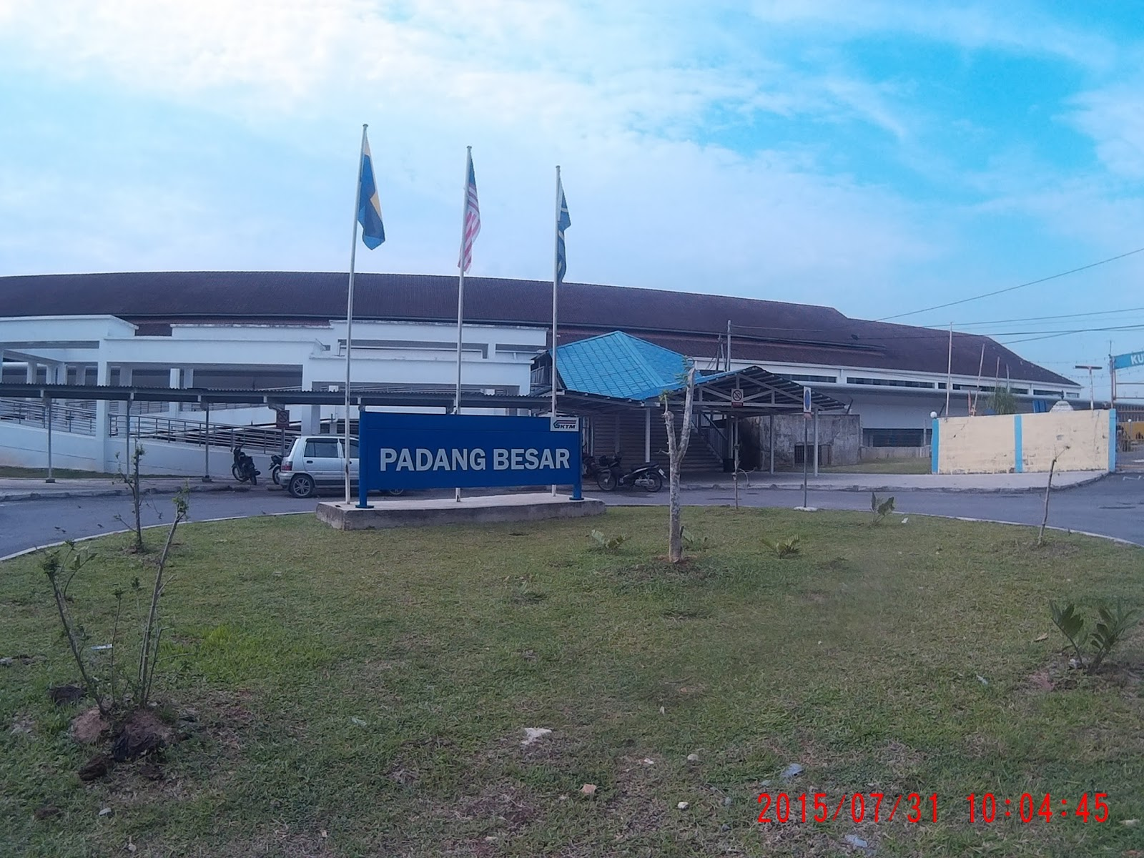
  How can you reach Padang Besar, Perlis?
By Rail
  The easiest way to get to Padang Besar is to take KTM's overnight Express Langkawi coach from Kuala Lumpur's Sentral Station. This coach departs daily at about 8pm heading towards Padang Besar, a journey that takes about 10 hours.
By Road
  From the North-South (PLUS) Highway, take the exit via Changlun and take the Changlun-Kuala Perlis highway to Kangar. From Kangar, continue on route heading towards Padang Besar.
To
Padang Besar
Perlis
For more information:
Tourism Malaysia Perlis Office
+604-978 1235/1213

Slide 2
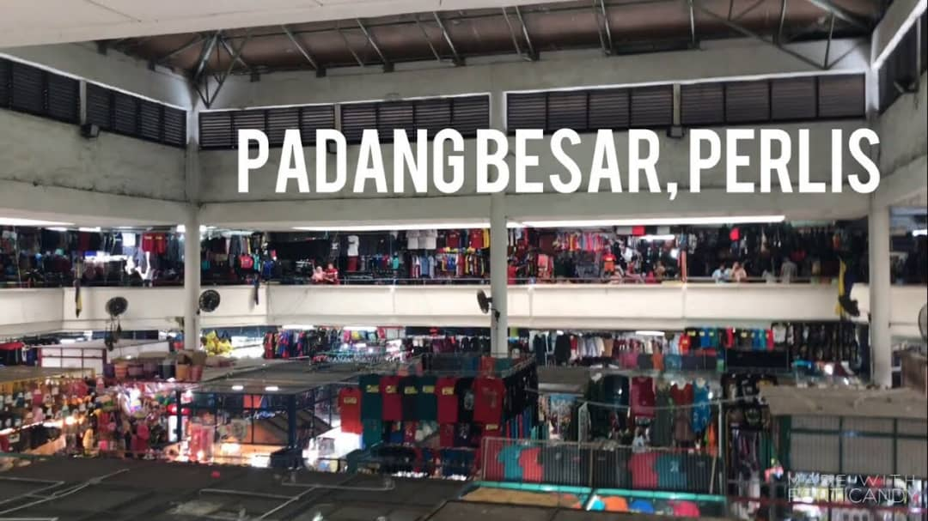
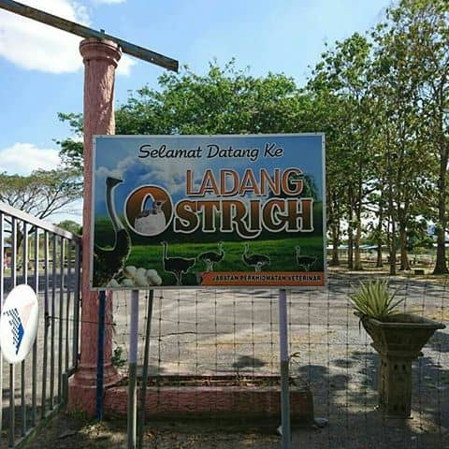
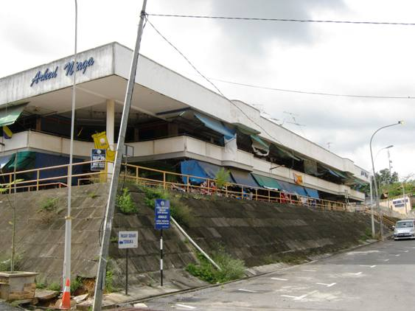

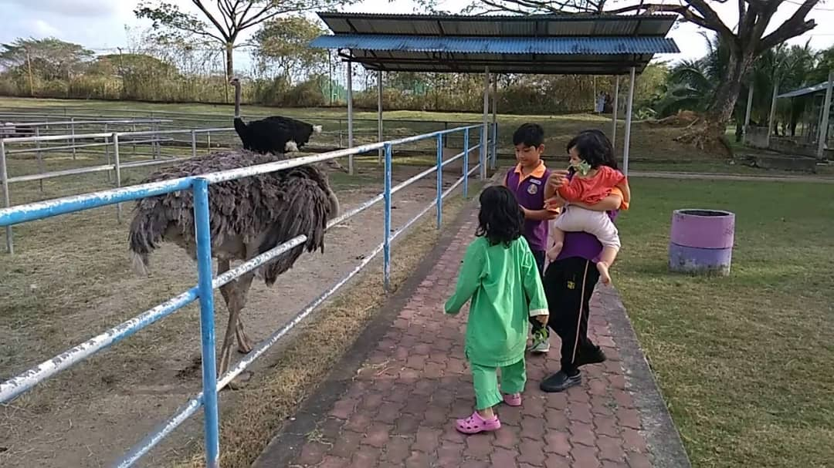
Padang Besar 'Arked Niaga' is a popular shopping heaven for both Malaysian and Thailand since 1960. Most visitors come by during the weekends to get their shopping supply, sometimes up thousands of visitors at one time. Though it's not the glamour high end market, Padang Besar sure has its own charm. It is a blend of 2 neighboring countries cultures with many local products to offer. The range of products includes textile, fashion, handicraft, food, jewelry and ironware. Most Malaysian would visit the Complex Aked Niaga and Gapura Square, whereas the Thai prefer to shop at Jalan Besar.
Ostrich Park is located near the road from Kangar heading
to Padang Besar which has become popular among people, especially visitors who want to see the rare bird up close. It is located at the crossroads around 10 km from Padang Besar dealer. It became the focus as ostriches can be touched and fed by visitors. Ostrich farm is owned by the State Veterinary Perlis and is open daily.
Padang Besar is the merging point for Thais and Malaysians. Many Malaysians travel up to Thailand through this point and likewise for their Thai counterparts, on shopping, business or recreational trips. The railway station has a long platform, manned by Malaysians on one side and the Thais on the other. Besides the Immigration checkpoints and some signs, it is hard to distinguish where the border actually lies because culturally, both sides are so enmeshed. Beyond the rail tracks is Pekan Siam, bargain-hunters' paradise. The town is filled with textiles, clothing, handicraft, foodstuff, fruits and souvenirs.

