Slide 1
Sources of Happiness
Name | Matric number
OOI WEI HERNG | 181362335
ALAN LIM CHIN PING | 181362299
MOHD FARIS AIMAN BIN MOHAMAD HAFIZI | 181362313
MUHAMAD IMRAN BIN ZENOL ABIDIN | 181362316
MUHAMMAD HASMANIZAM BIN HASSAN | 181362323

Slide 2
INTROUCTION
Happiness is a state, in other words, it isn’t a long-lasting, permanent feature or personality trait, but a more fleeting, changeable state.
Happiness is equated with feeling pleasure or contentment, meaning that happiness is not to be confused with joy, ecstasy, bliss, or other more intense feelings.
Happiness can be either feeling or showing, meaning that happiness is not necessarily an internal or external experience, but can be both.

Slide 3
MAIN CONTENT
What is Happiness?
Happiness is the experience of joy, contentment, or positive well-being, combined with a sense that one’s life is good, meaningful, and worthwhile.
Happiness is captures the fleeting positive emotions that come with happiness, along with a deeper sense of meaning and purpose in life.
Happiness is a feeling of contentment, that life is just as it should be. Perfect happiness, enlightenment, comes when you have all of your needs satisfied.

Slide 4
MAIN CONTENT
What’s make people happy?
Happiness is when your life fulfils your needs.
Happiness comes when you feel satisfied and fulfilled. Happiness is a feeling of contentment.
Happiness is when you to somewhere that beautiful place makes you feel happy.

Slide 5
MAIN CONTENT
What is positives effects of happiness
Happiness improves our vision and our performance in many other areas . For example, student who are happy, they can study and perform better in their class.

Slide 6
MAIN CONTENT
What the Advantages of Being Happiness?
Happiness is good for our health, happy people are less likely to get sick, and they live longer.
Happiness is good for our relationships. Happy people are more likely to get married and to have fulfilling marriages, and they have more friends.
Happy people cope better with stress and trauma.
Happy people are more creative and are better able to see the big picture.
Happy people are more generous.

Slide 7
SOURCE OF INFORMATION
Sources can be find anytime
  E-books
  Blog
  Online article
  Mental health magazine
  Lecturer
Sources that have to take time to collect
  Survey (WEEK 5 ~ WEEK 7)
  Others’ research (WEEK 7 ~ WEEK 10)

Slide 8
SIGNIFICANCE AND LEARNING
Significance
Protects your heart
  The initially happiest participants had a lower heart rate on follow-up (about six beats slower per minute), and the happiest participants during the follow-up had better blood pressure.
Avoid Stress and Anxiety
  Happiness makes you resilient. It helps you recover from stress

Slide 9
SIGNIFICANCE AND LEARNING
Learning
Get good grade
  Happiness is positively associated with intrinsic motivation (a personal drive to learn) for all students, and also with extrinsic motivation (outside sources like rewards and praise) for students make the grade

Slide 10
CONCLUSION
In conclusion, happiness is very important to everyone because it is extremely vital to our own goals in life and can help us achieve many other cherished personal ambitions and goals.

Slide 11
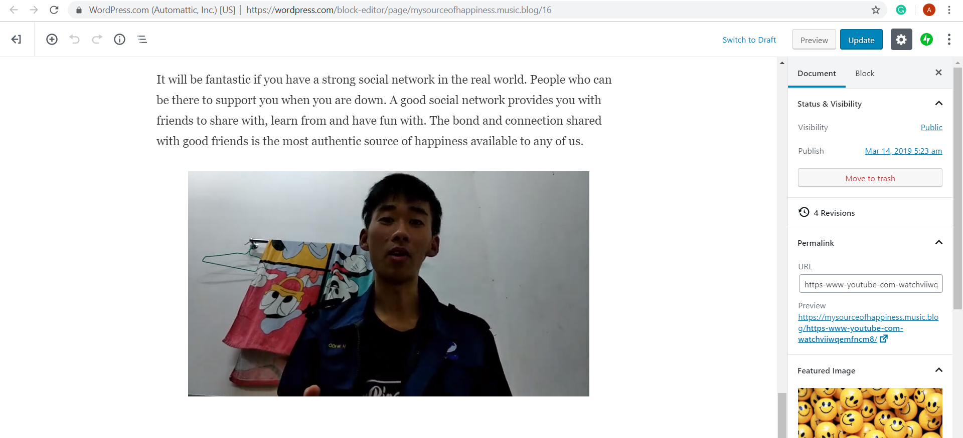
VIDEO / SCREENSHOT OF VIDEO

